Slide 1
CSY3025 Artificial Intelligence Techniques
Ensemble Learning and Random Forests

Slide 2
https://github.com/ageron/handson-ml2/blob/master/06_decision_trees.ipynb

Slide 3
Ensemble Learning

Slide 4

Ensemble Learning
Suppose you ask a complex question to thousands of random people, then aggregate their answers. In many cases you will find that this aggregated answer is better than an expert’s answer. This is called the wisdom of the crowd.
Similarly, if you aggregate the predictions of a group of predictors (such as classifiers or regressors), you will often get better predictions than with the best individual predictor. A group of predictors is called an ensemble; thus, this technique is called Ensemble Learning
You will often use Ensemble methods near the end of a project, once you have already built a few good predictors, to combine them into an even better predictor. In fact, the winning solutions in Machine Learning competitions often involve several Ensemble methods.
Notes:
https://miro.medium.com/max/1400/1*EVTtJMFat9WERM7BuShtkQ.png

Slide 5
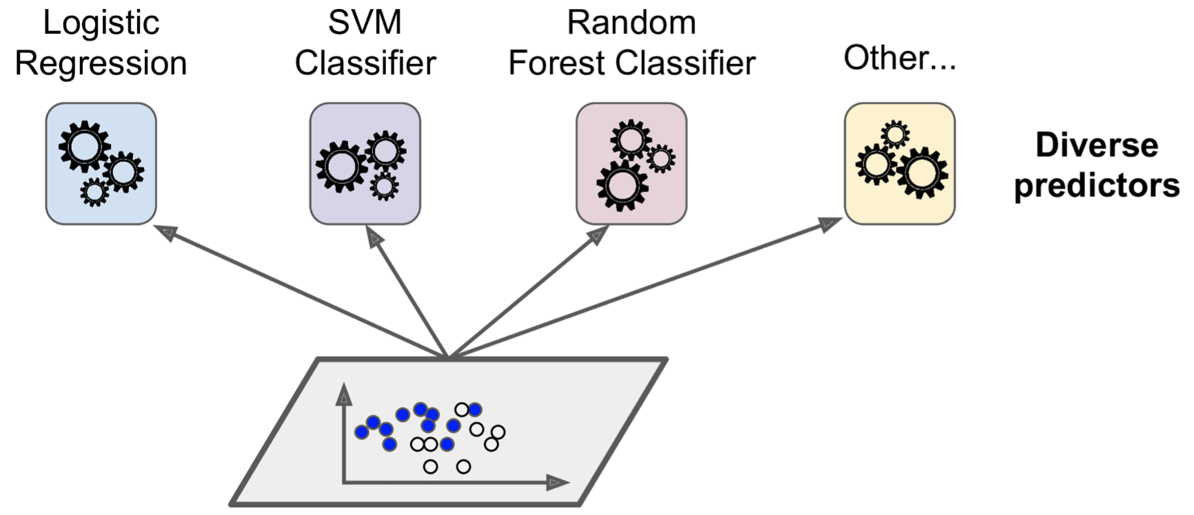
Voting Classifiers
Suppose you have trained a few classifiers, each one achieving about 80% accuracy.

Slide 6
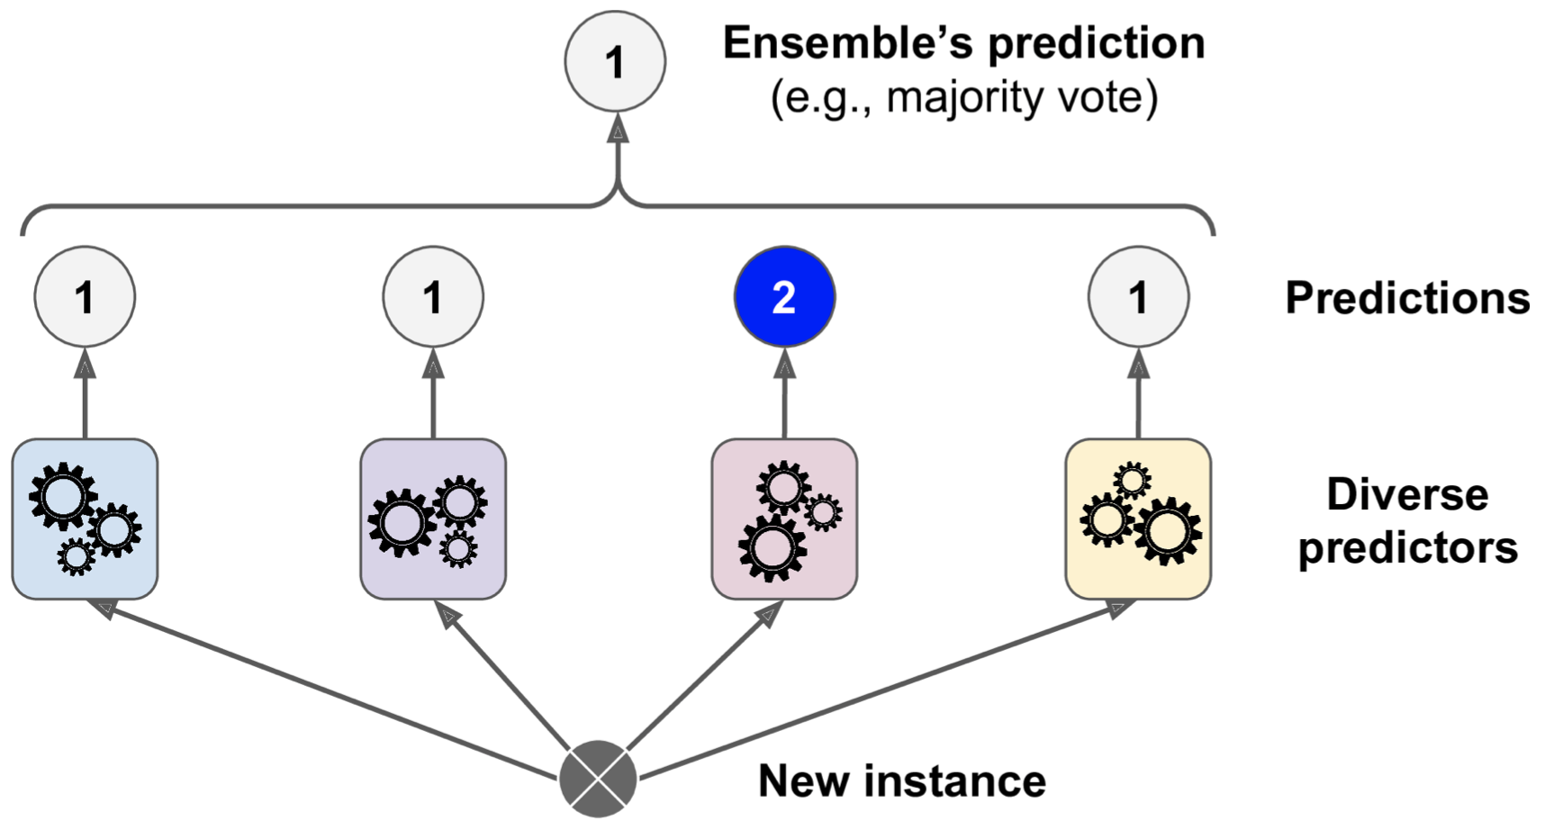
Voting Classifiers
A very simple way to create an even better classifier is to aggregate the predictions of each classifier and predict the class that gets the most votes. This majority-vote classifier is called a hard voting classifier
A few weak models -> strong model.

Slide 7
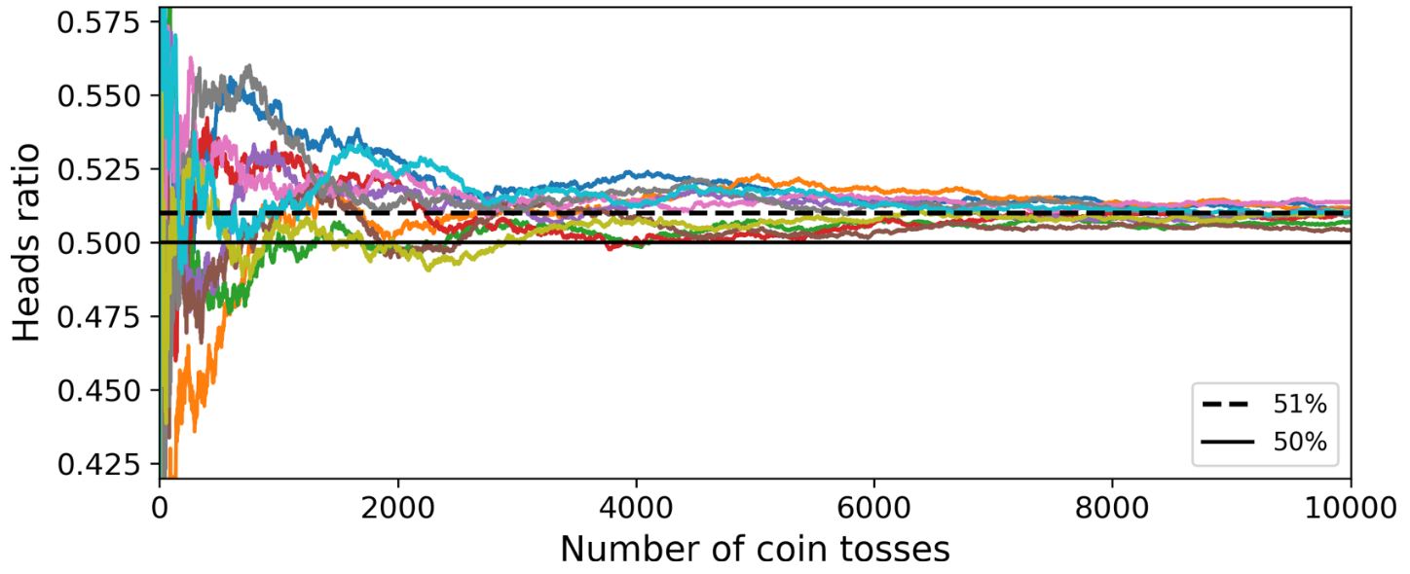
Law of large numbers
a slightly biased coin that has a 51% chance of coming up heads, and 49% chance of coming up tails. The more you toss the coin, the higher the probability to obtain the majority of heads (e.g., with 10,000 tosses, the probability climbs over 97%).
This is due to the law of large numbers: as you keep tossing the coin, the ratio of heads gets closer and closer to the probability of heads (51%).

Slide 8
Voting Classifiers (hard)
from sklearn.ensemble import RandomForestClassifier
from sklearn.ensemble import VotingClassifier
from sklearn.linear_model import LogisticRegression
from sklearn.svm import SVC
log_clf = LogisticRegression()
rnd_clf = RandomForestClassifier()
svm_clf = SVC()
voting_clf = VotingClassifier(
estimators=[('lr', log_clf), ('rf', rnd_clf), ('svc', svm_clf)],
voting='hard')
voting_clf.fit(X_train, y_train)
>>> from sklearn.metrics import accuracy_score
>>> for clf in (log_clf, rnd_clf, svm_clf, voting_clf):
... clf.fit(X_train, y_train)
... y_pred = clf.predict(X_test)
... print(clf.__class__.__name__, accuracy_score(y_test, y_pred)) ...
LogisticRegression 0.864
RandomForestClassifier 0.896
SVC 0.888
VotingClassifier 0.904
Get a diverse set of classifiers is to use very different training algorithms.

Slide 9
Voting Classifiers (soft)
If all classifiers are able to estimate class probabilities (i.e., they have a pre dict_proba() method), then you can tell Scikit-Learn to predict the class with the highest class probability, averaged over all the individual classifiers. This is called soft voting.
voting_clf = VotingClassifier(
estimators=[('lr', log_clf), ('rf', rnd_clf), ('svc', svm_clf)],
voting='soft')
voting_clf.fit(X_train, y_train)
LogisticRegression 0.864
RandomForestClassifier 0.896
SVC 0.888
VotingClassifier 0.92

Slide 10
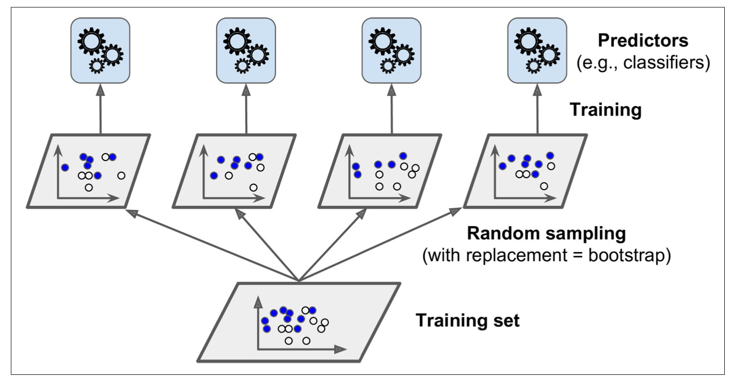
Bagging and Pasting
Another approach is to use the same training algorithm for every predictor, but to train them on different random subsets of the training set.
When sampling is performed with replacement, this method is called bagging (short for bootstrap aggregating). When sampling is performed without replacement, it is called pasting.

Slide 11
Bagging and Pasting in Scikit-Learn
from sklearn.ensemble import BaggingClassifier
from sklearn.tree import DecisionTreeClassifier
bag_clf = BaggingClassifier(
DecisionTreeClassifier(), n_estimators=500,
max_samples=100, bootstrap=True, n_jobs=-1)
bag_clf.fit(X_train, y_train)
y_pred = bag_clf.predict(X_test)
Scikit-Learn offers a simple API for both bagging and pasting with the BaggingClas sifier class.
The above code trains an ensemble of 500 Decision Tree classifiers, each trained on 100 training instances randomly sampled from the training set with replacement. The n_jobs parameter tells Scikit-Learn the number of CPU cores to use for training and predictions (–1 tells Scikit-Learn to use all available cores):

Slide 12
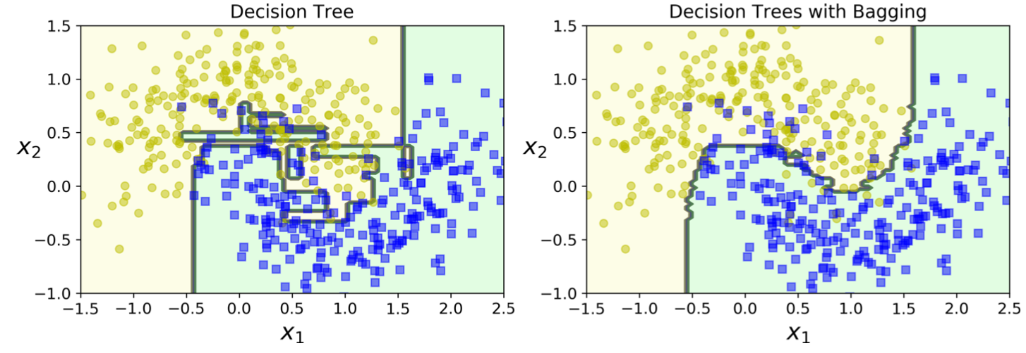
Bagging and Pasting in Scikit-Learn
The ensemble’s predictions will likely generalize much better than the single Decision Tree’s predictions: the ensemble has a comparable bias but a smaller variance (it makes roughly the same number of errors on the training set, but the decision boundary is less irregular).

Slide 13
Random Forests

Slide 14
Random Forests
A Random Forest is an ensemble of Decision Trees, generally trained via the bagging method. Instead of building a BaggingClassifier and passing it a DecisionTreeClassifier, you can instead use the RandomForestClassifier class, which is more convenient and optimized for Decision.
The following code trains a Random Forest classifier with 500 trees (each limited to maximum 16 nodes).
from sklearn.ensemble import RandomForestClassifier
rnd_clf = RandomForestClassifier(n_estimators=500, max_leaf_nodes=16, n_jobs=-1)
rnd_clf.fit(X_train, y_train)
y_pred_rf = rnd_clf.predict(X_test)
Notes:
bag_clf = BaggingClassifier(
DecisionTreeClassifier(splitter="random", max_leaf_nodes=16),
n_estimators=500, max_samples=1.0, bootstrap=True, n_jobs=-1)

Slide 15
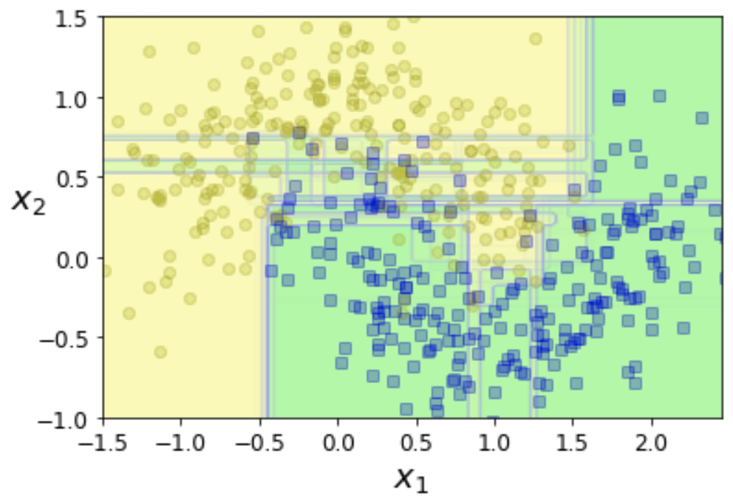
Random Forests
15 trees

Slide 16
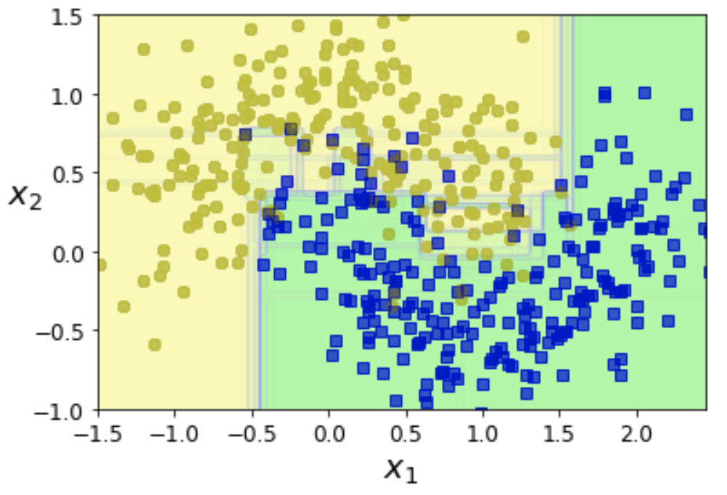
Random Forests
50 trees

Slide 17
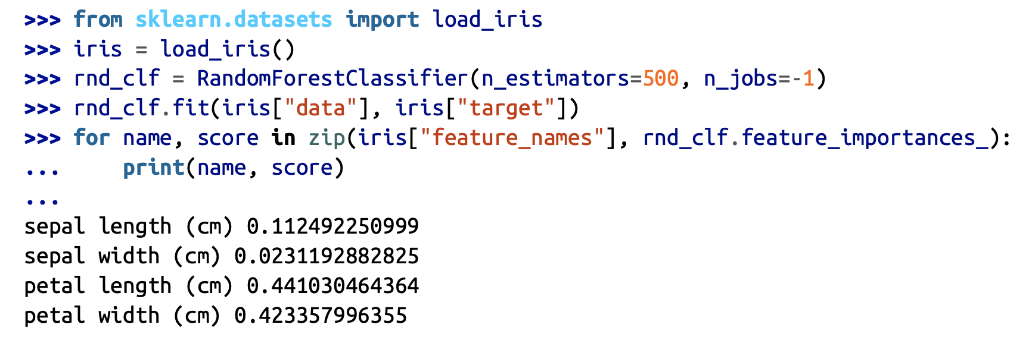
Feature Importance
A great quality of Random Forests is that they make it easy to measure the relative importance of each feature. Scikit-Learn measures a feature’s importance by looking at how much the tree nodes that use that feature reduce impurity on average (across all trees in the forest).
Scikit-Learn computes this score automatically for each feature after training, then it scales the results so that the sum of all importances is equal to 1. You can access the result using the feature_importances_ variable.

Slide 18
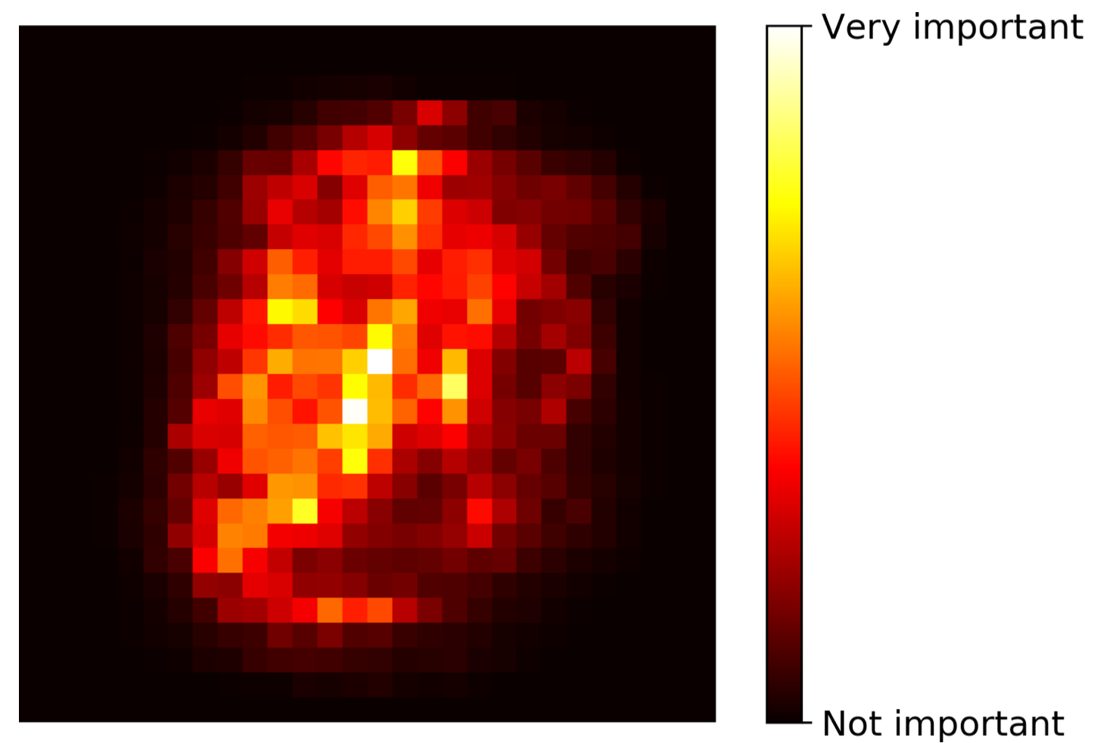
Feature Importance
Similarly, if you train a Random Forest classifier on the MNIST dataset and plot each pixel’s importance, you get the image represented

Slide 19
Boosting

Slide 20
Boosting
Boosting refers to any Ensemble method that can combine several weak learners into a strong learner. The general idea of most boosting methods is to train predictors sequentially, each trying to correct its predecessor.
AdaBoost (short for Adaptive Boosting)
Gradient Boosting.

Slide 21
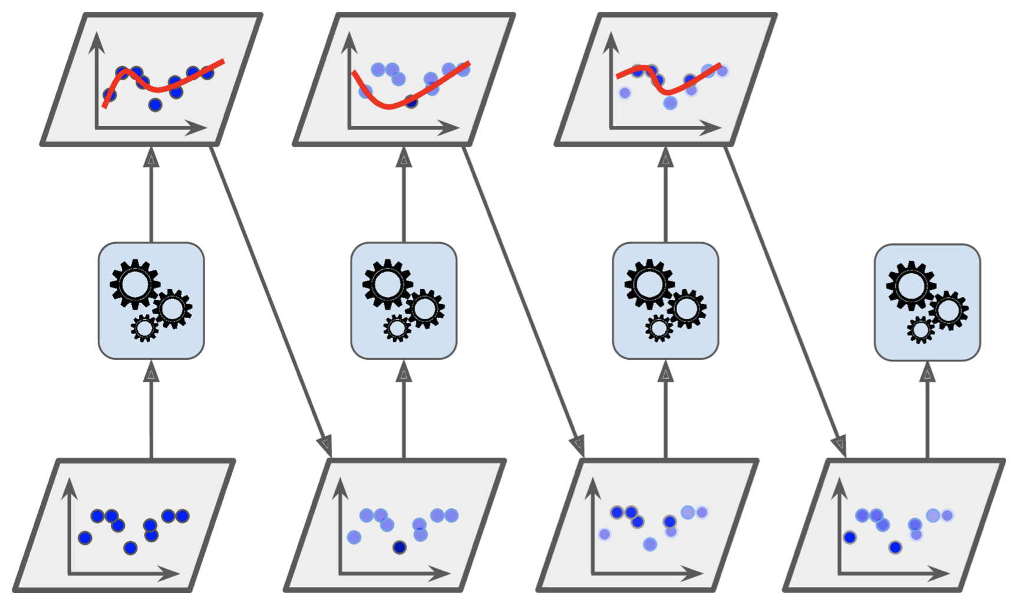
AdaBoost
One way for a new predictor to correct its predecessor is to pay a bit more attention to the training instances that the predecessor underfitted. This results in new predictors focusing more and more on the hard cases.

Slide 22
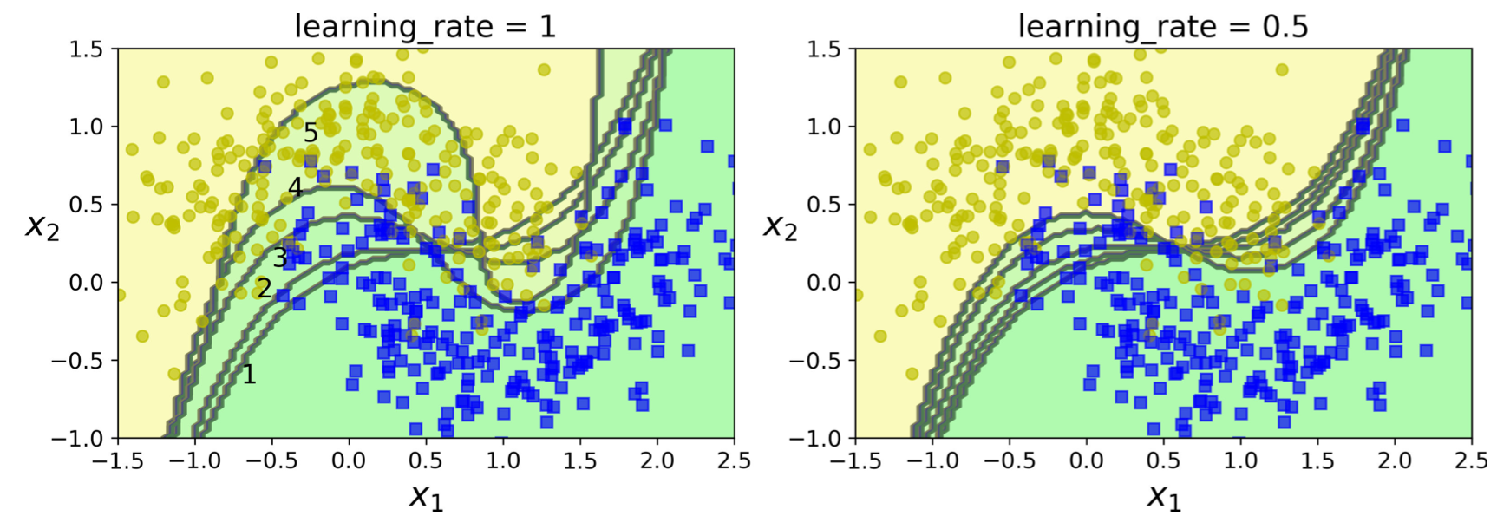
AdaBoost
There is one important drawback to this sequential learning technique: it cannot be parallelized (or only partially), since each predictor can only be trained after the previous predictor has been trained and evaluated. As a result, it does not scale as well as bagging or pasting.

Slide 23
Gradient Boosting
Just like AdaBoost, Gradient Boosting works by sequentially adding predictors to an ensemble, each one correcting its predecessor. This method tries to fit the new predictor to the residual errors made by the previous predictor.
from sklearn.tree import DecisionTreeRegressor
tree_reg1 = DecisionTreeRegressor(max_depth=2)
tree_reg1.fit(X, y)
y2 = y - tree_reg1.predict(X)
tree_reg2 = DecisionTreeRegressor(max_depth=2)
tree_reg2.fit(X, y2)
y3 = y2 - tree_reg2.predict(X)
tree_reg3 = DecisionTreeRegressor(max_depth=2)
tree_reg3.fit(X, y3)
y_pred = sum(tree.predict(X_new) for tree in (tree_reg1, tree_reg2, tree_reg3))

Slide 24
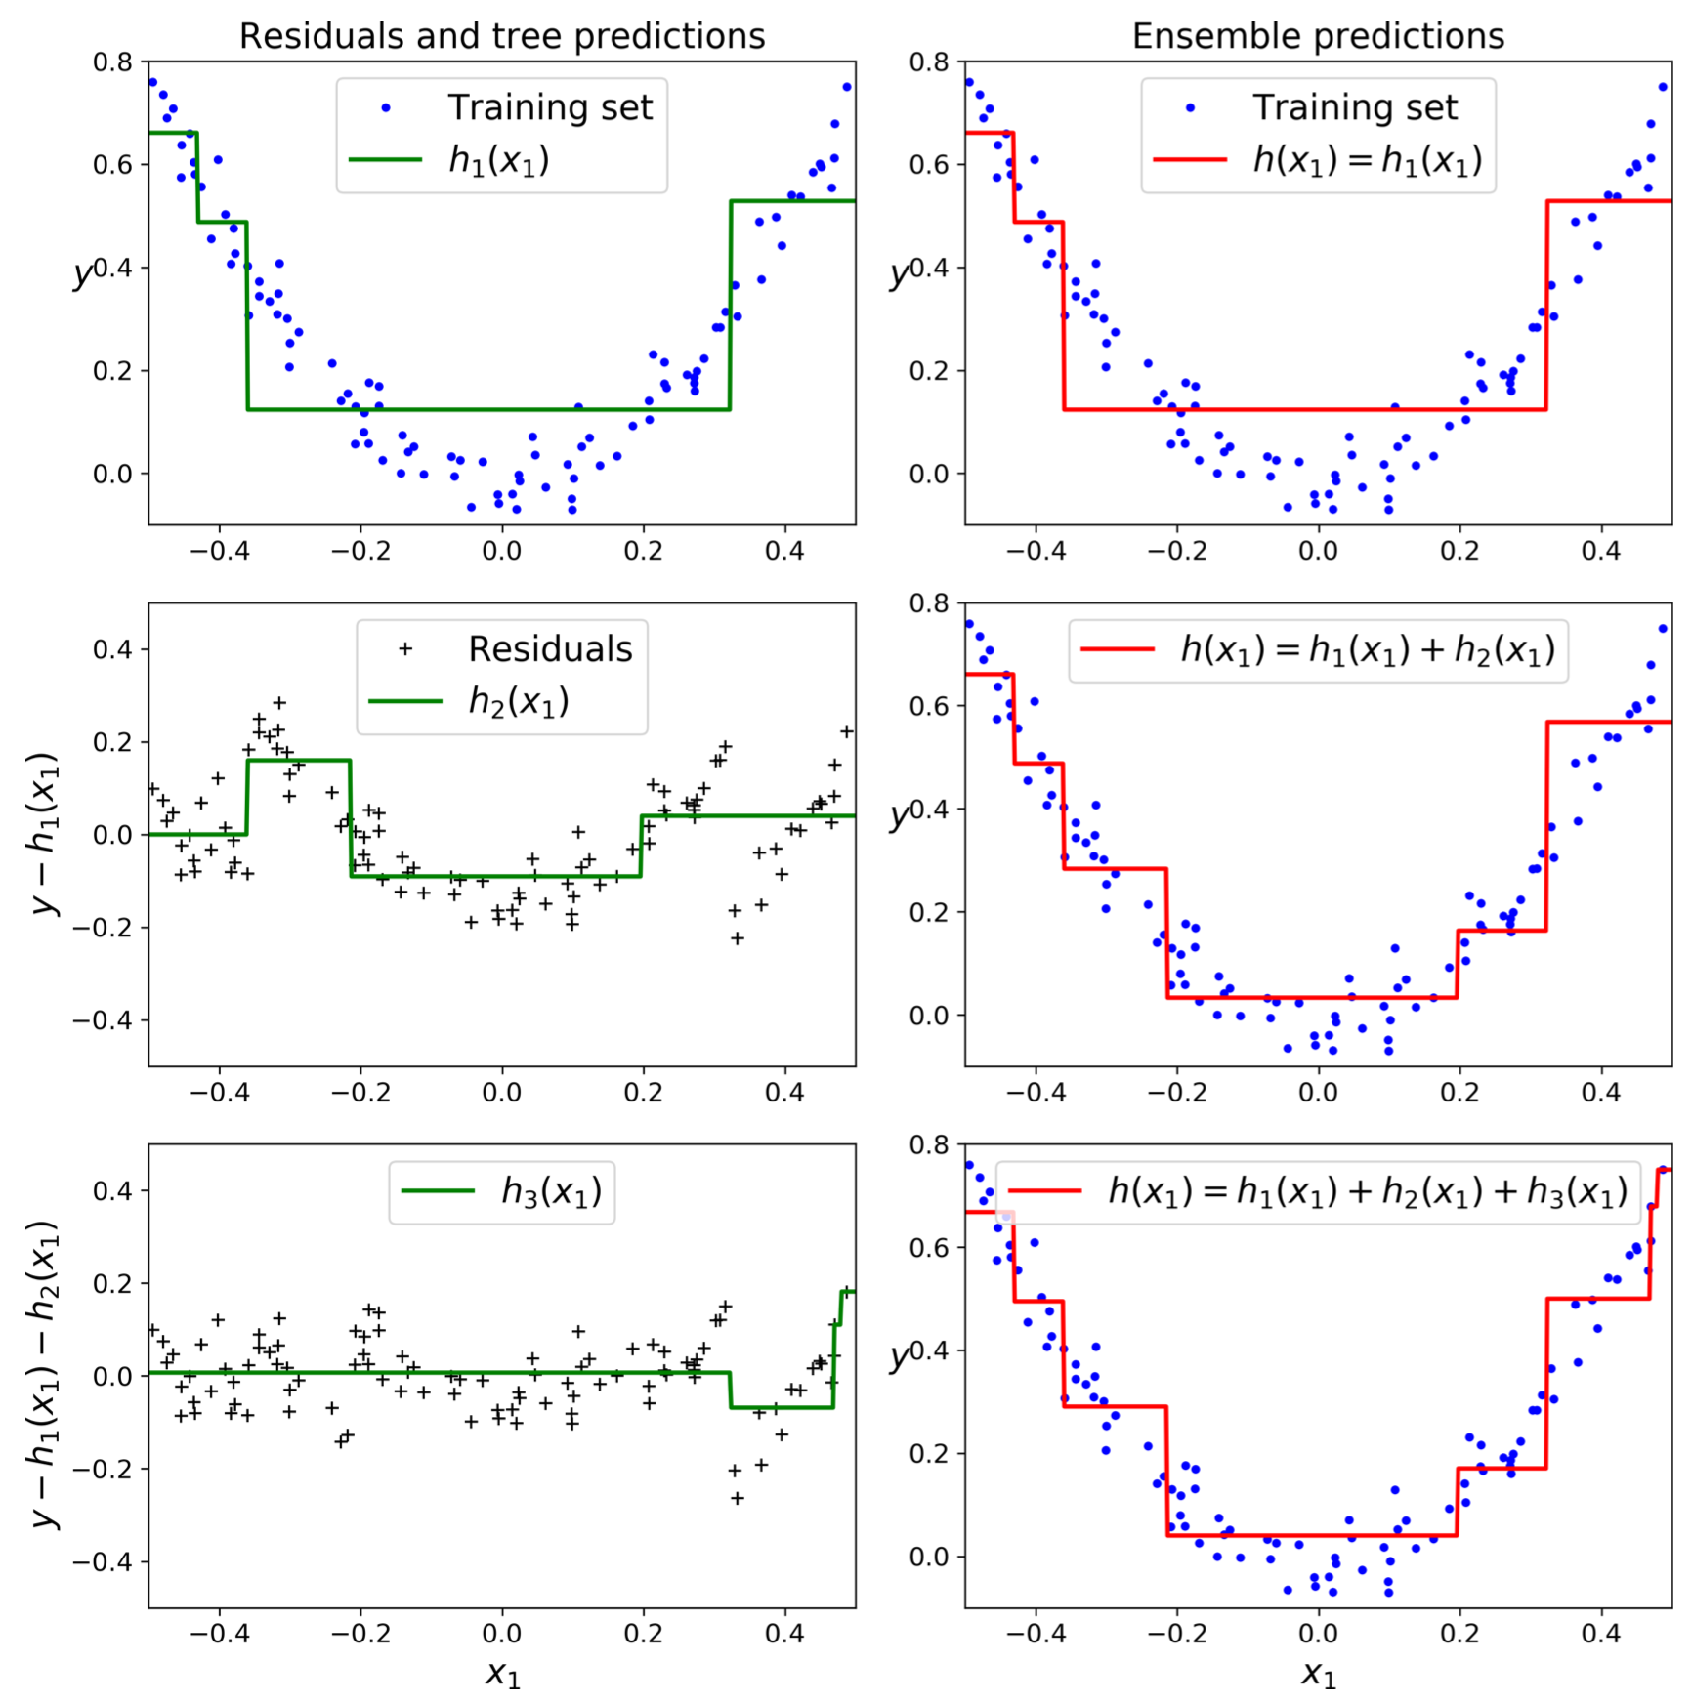
Gradient Boosting
from sklearn.ensemble import GradientBoostingRegressor
gbrt = GradientBoostingRegressor(max_depth=2, n_estimators=3, learning_rate=1.0)
gbrt.fit(X, y)

